Slide 1
Brillians (SupraVISTA) Test Results Notification An Add-on Module for Brillians

Slide 2
This presentation is designed to Explain
VHA’s Test Result Communication policy and current state of compliance.
The nature and benefits of the “Test Results Notification” software module
Address providers’ concerns.
Outline potential usage in PACT settings.
More Info: SupraVISTA TestResults | SupraVISTA
This is a Commercial, Off The Shelf (COTS) software.
A software license is required for each VAMC/VISN.

Slide 3
VHA Test Results Communication Policy
ALL test results are communicated to the patient by the Ordering Provider within the specified time-frame. (VA Directive 1088 & VAMC’s local policy.)
The “Actionable” test results must be communicated to the patient within 7 days of when result become available.
Normal or “Non-actionable” tests results must be communicated within 14 days of when result available.
Note: Face-to-face, phone and letter are acceptable means for communication. There should be “evidence” of such communication in the medical record.

Slide 4
How much time does each provider spend on writing Test Result Letters per week?
Key Considerations
Compliance: What percentage of Test result letters do we actually write, versus the “should have” number?
What is the “COST” of non-compliance to the VAMC and providers if we fail OIG inspection?
(Hint: Gazillion chart reviews for months.)
View Alerts: What is the impact on View Alerts?

Slide 5
Test Result Notification: Present State
Most VAMCs have unacceptably low compliance with VHA’s Test Result Notification policy – about 50-60% at best. The OIG expects >95% compliance.
Inconsistent compliance by providers and services.
High time-cost of manually generated letters – up to four hours per week of each Primary Care provider’s time (additional time for specialty care and ED providers).
Negative impact on number of View Alerts – providers have to turn on ALL notifications to receive “normal” test results.
“Failure to notify the patient and follow-up on abnormals.” This is a patient safety and legal risk.

Slide 6
Future State and Positive Outcomes
Near-100% compliance with the VHA’s “Test Result Notification” policy.
Virtually NO provider time or effort needed. Automation reduces non-value-added work and frees-up the providers to focus on the clinical work.
Positive impact on number of View Alerts – providers can turn off notifications for the “normal” test results and focus on the “abnormal.”
Patient Safety: Well informed patients ask for follow-up on significant abnormal findings if the provider fails to follow-up on an abnormal test result (e.g., due to staff turn-over or prolonged leave).

Slide 7
Positive Impact on Patient Care
Providers continue to receive View Alerts for abnormal findings as they do now.
Providers address the abnormal findings with due urgency as they do now, including immediate, direct patient contact via phone or letter, if necessary.
No changes to providers’ workflow!
Positive Impact:
Staff Morale
Free up ~4 hours per week of the provider time for clinical work and new initiatives.

Slide 8
Brillians: Key Features and Benefits
High compliance with “policy” with virtually no effort.
Free up providers to focus on clinical work resulting in better clinical outcomes and morale.
Supports automated batch printing of letters using various patient selection methods.
Supports manually generated letters with option to send by standard or certified mail.
Batch print “Form Letters” e.g., we want to inform all patients, who had appointments in clinics A, B and C between dates X and Y (e.g., about potential scabies exposure), Or, inform patients in PACT A about provider change.

Slide 9
How does it work?
The user selects the target patients. The target patients can come from PACT panel(s), SSN list, or Clinic Appointments.
The software looks at EACH target patient’s chart for test results in the specified date-range (typically, past 7 days). If test results are found, a letter is created, saved in VistA/CPRS under the proper note title and signed. This completes the loop with NO manual work!
If we process all the PC panels each week, ALL the patients are taken care of, regardless of the “Actionable” status, or who ordered the test.

Slide 10
How much work for “me”? Any clinical employee (e.g., MSA, LPN) can print letters.
Once a week, on “your” designated day, start the application and login.
After CPRS-like Login, it takes 5 clicks (about one-two minute) to start the batch process.
After starting the process, the user can lock the computer, do other work, or go home.
!!! All Set !!!
All the Test Results letters are done for the week!

Slide 11
What if the provider wants to review and optionally add comments before sending the letters?
The App has an option to save the test result letters as UN-signed progress notes.
In CPRS, following the batch processing, the unsigned progress notes show up as View Alerts.
The user processes the View Alerts as usual.
At this point, the user can review test result letter, optionally add comments, and sign the note.

Slide 12
Unfounded Concerns
Patient will be confused because there is no explanation of labs/tests in letters. False.
MyHealtheVet & private sector patient portals have NO explanation. (For abnormal findings, the provider ALREADY contacted the patient when he/she received the View Alert and explained the findings and plan. No need to duplicate explanation in the letter but there is an option to add comments in the letter. See slide in this presentation.)
It will increase my phone call. False.
It actually DECREASES phone calls.
I will miss clinical findings. False. The View Alerts are alive and well.
The patient may see the test results before I do. False. The provider gets a View Alert as soon as a test is resulted.
It takes 7-10 days for the letter to reach the patient so plenty of time for the provider to contact the patient before he/she gets the letter.
MyHealtheVet: Test results are displayed after 3 days, i.e., well before the patient will receive the letter.

Slide 13
Return on Investment (ROI)
Provider time savings: Dollar value of about 4 hours per PC provider, per week (i.e., 10% of the 40-hour week).
Avoid the OIG ding: Near-100% compliance with VHA Policy.
Reduce volume of View Alerts: Users can turn-off view alerts for normal labs and normal imaging.
Reduce interruptions to patient care: Providers do not need to stop and manually create a letter (4-5 minutes each) when they process view alerts. They only focus on the clinical issues.
Improve provider satisfaction and retention: Reduce burn-out by eliminating non-value-added scut work.
Patient safety: “Failed to follow-up findings” on the provider’s end are caught by the patient. Better to hear from the patient in 2 weeks than to hear from his lawyer in 2 years.

Slide 14
General rule about Compliance
50-60% compliance: Ask and remind people.
70-75% compliance: Reminders PLUS carrots and sticks.
90-95% compliance: Automate! Remove the human from the process.

Slide 15
Technical, Configuration and Misc. Information on the next few slides.

Slide 16
Print letters in the Mail Room/Remote Printer (VistA Configuration)
The Test Results application saves the auto-created letter in CPRS/VistA under the specified progress note title and signs it.
When a progress note with the specific progress note title (e.g., “Test Result Notification Letter”) is created and signed, the VistA system can print the progress note on the specified printer.
The VistA system can be easily configured to print test results letters to any printer on the network.
VAMCs can use this feature to print letters directly in the mail room, thus further reducing the clerical burden on the clinical staff.

Slide 17
Proposed guidance on the next slide
The next slide shows a way to spread-out the work on different weekdays
Next slide is just for illustration.
The application does not limit how the VAMC chooses to schedule letter printing.
Application is designed to be very flexible to meet various needs.

Slide 18
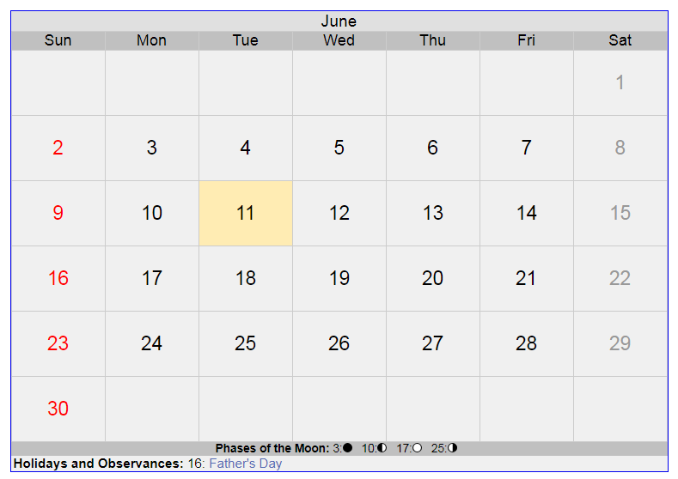
Each PACT picks his/her week-day. User prints test results on the SAME weekday for the previous 7 days. This ensures that ALL test results are taken care of.
User #1: Print for 7 days, Tue to Monday
Print every Tuesday
User #2: Print for Thursday to Wed
Print every Thursday
Tip: Setup a RECURRING Outlook calendar appointment for yourself/team.

Slide 19
What to expect for ~1000 patient panel Sample report
Report's Date range: StartDate: 5/7/2019 End Date: 5/13/2019
Num of days in Range: 7
Team(s): XYZ PACT GREEN [972] (Index=156399)
Total num of patients: 972
Num of letters printed: 63
Job Start Date/Time: 5/14/2019 11:07:44 AM
Job End Date/Time: 5/14/2019 11:31:42 AM
Print Job Total Time: 0 hours, 23 min., 57 Sec.
This time is for the “Print Job” to complete, not the user. After starting the process (one-two minutes), the user can lock the computer, do other things, or go home at end of the day.

Slide 20
Configurable Options: Turn On/Off in VAMC Config
Automatically generate, save in VistA and sign the test result progress notes.
Print the paper copy on the local or remote printer.
Exclude/hide certain tests results that should not be reported by mail (HIV, Sickle cell, etc.).
The deceased patients are always excluded.
Exclude inpatients
Customizable, reassuring text in header/footer of each clinical section (e.g., labs, imaging)
Do not print letter if certain tests are the ONLY ones to report, e.g., POC Glucose, PT, INR.
And many more options which give the VAMC full control
More Details: SupraVISTA TestResults | SupraVISTA

